Slide 1

Predict The US Presidential Election 2020 From The Tweets of People
By:
Fatima Vahidnezhad
Course Name: DBDA.X408.(24) Introduction to Machine Learning and Data Mining
Batch: Autumn 2020

Slide 2
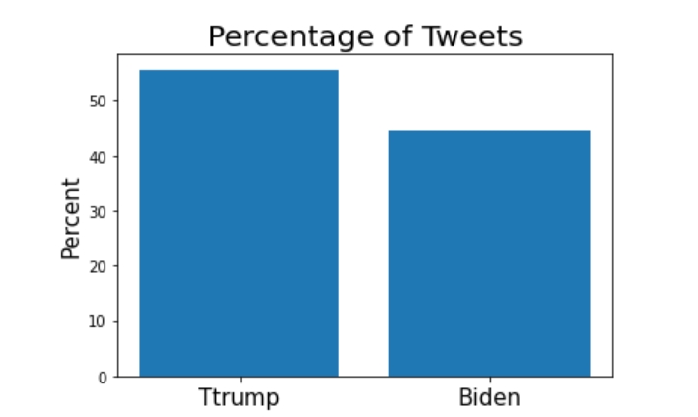
Oct 15th, 2020 - Nov 8th, 2020
Number of tweets: 1.72M
https://www.kaggle.com/manchunhui/us-election-2020-tweets

Slide 3
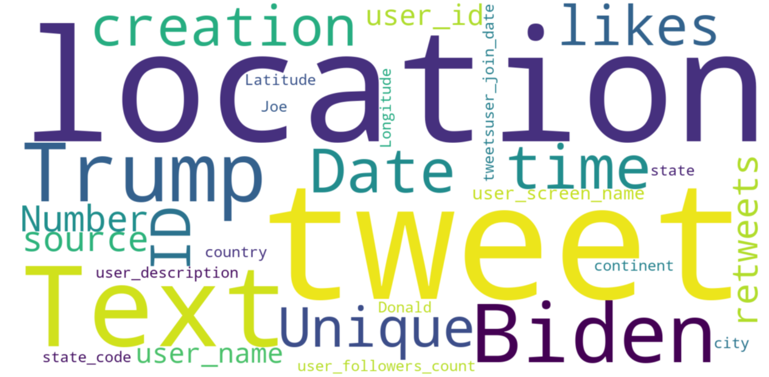
Features of Datasets
Using Wordcloud library to show features of dataset

Slide 4
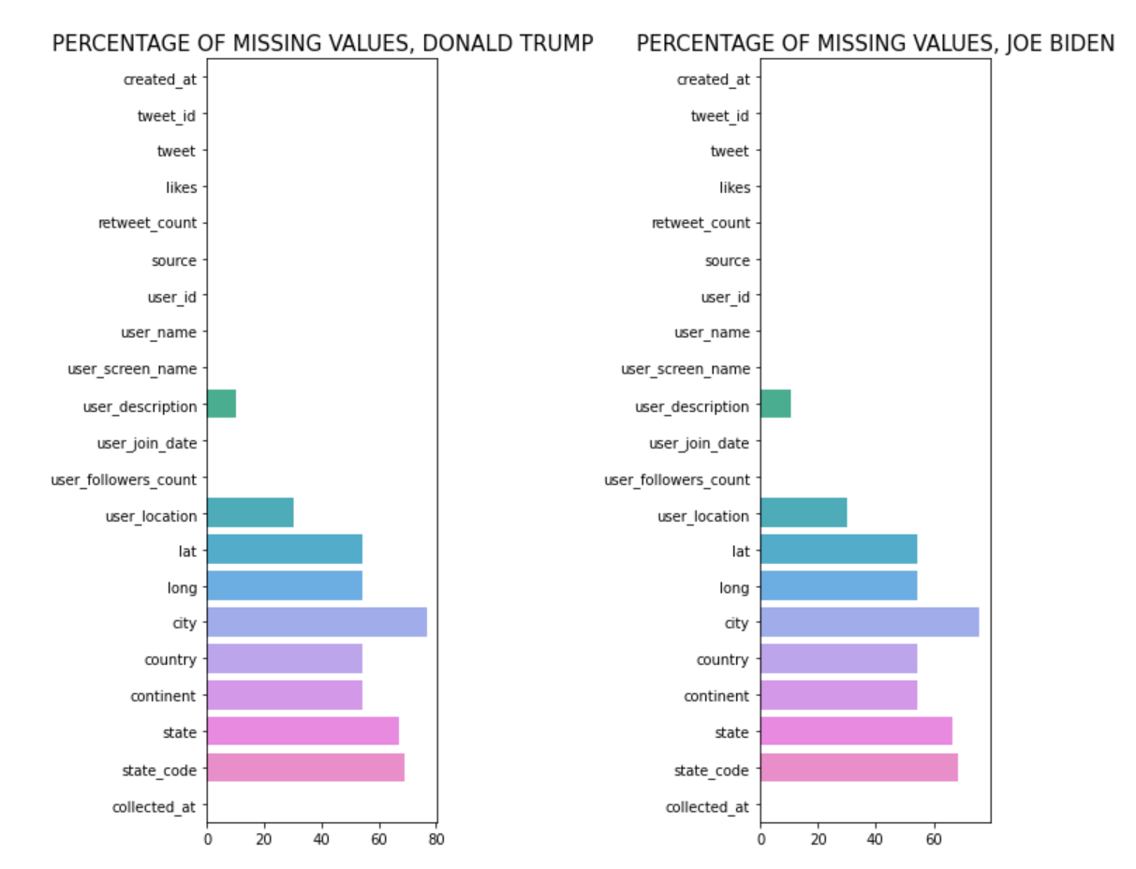
Missing Values
Notes:
Dataset is about 1.5 million tweets.

Slide 5
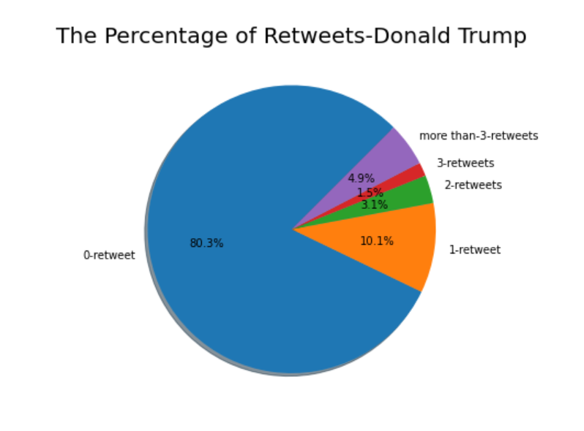
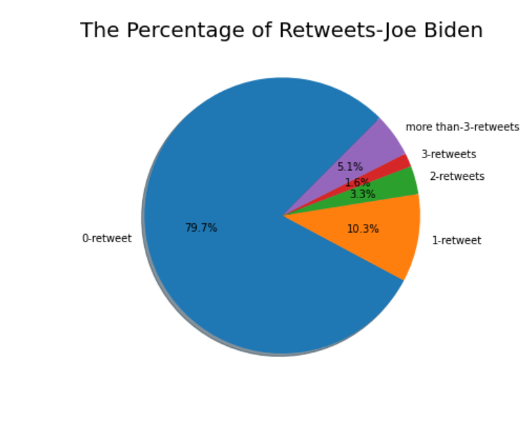
Retweets
Notes:
A lot of tweets did not tweet again and only 20 percent of them retweeted.

Slide 6
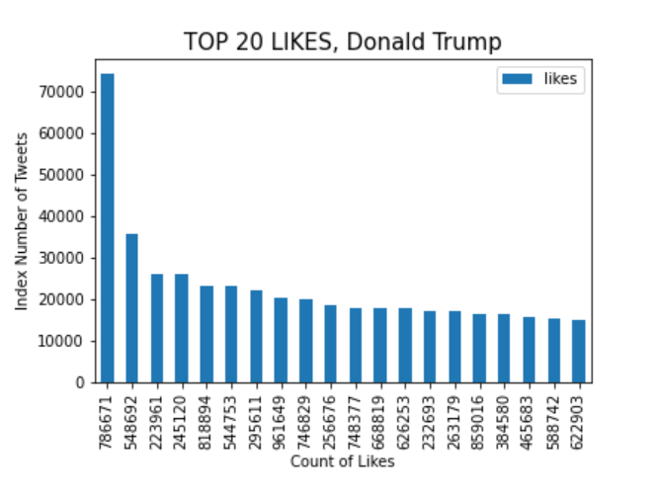
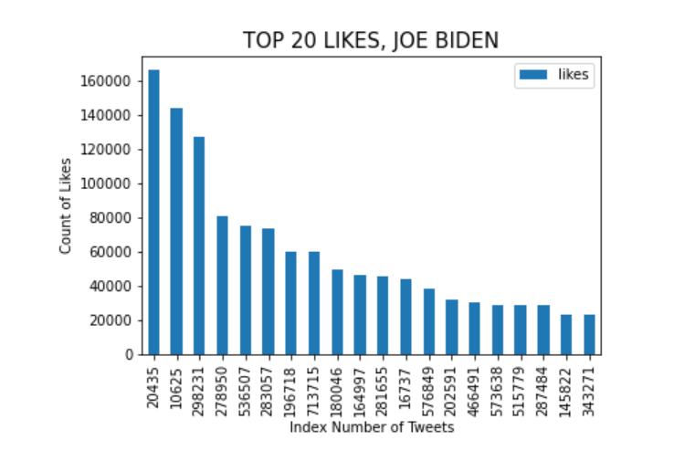
Likes

Slide 7
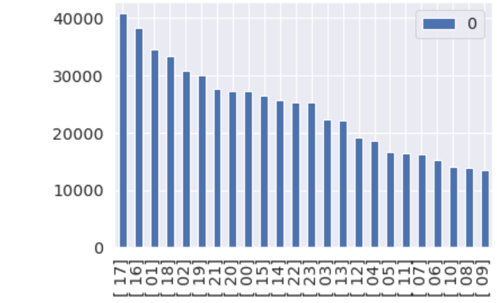

Hour
The number of tweets at 16 and 17
Were more than other hours
Using re library to split hour from date column
Using Matplotlib library to find count of tweets

Slide 8
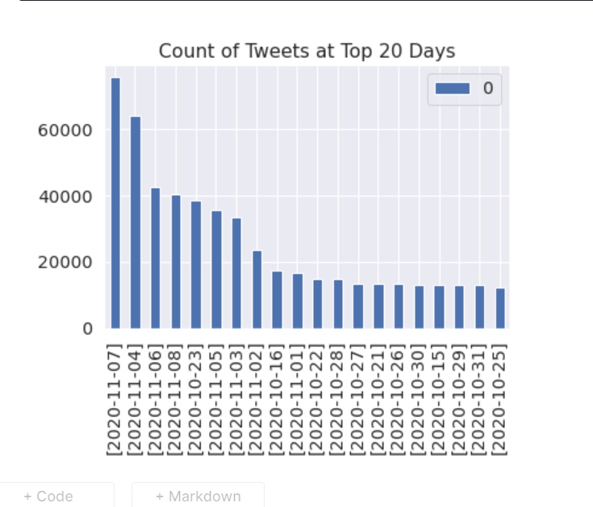
Day
The number of tweets on 7 November
were more than other days

Slide 9
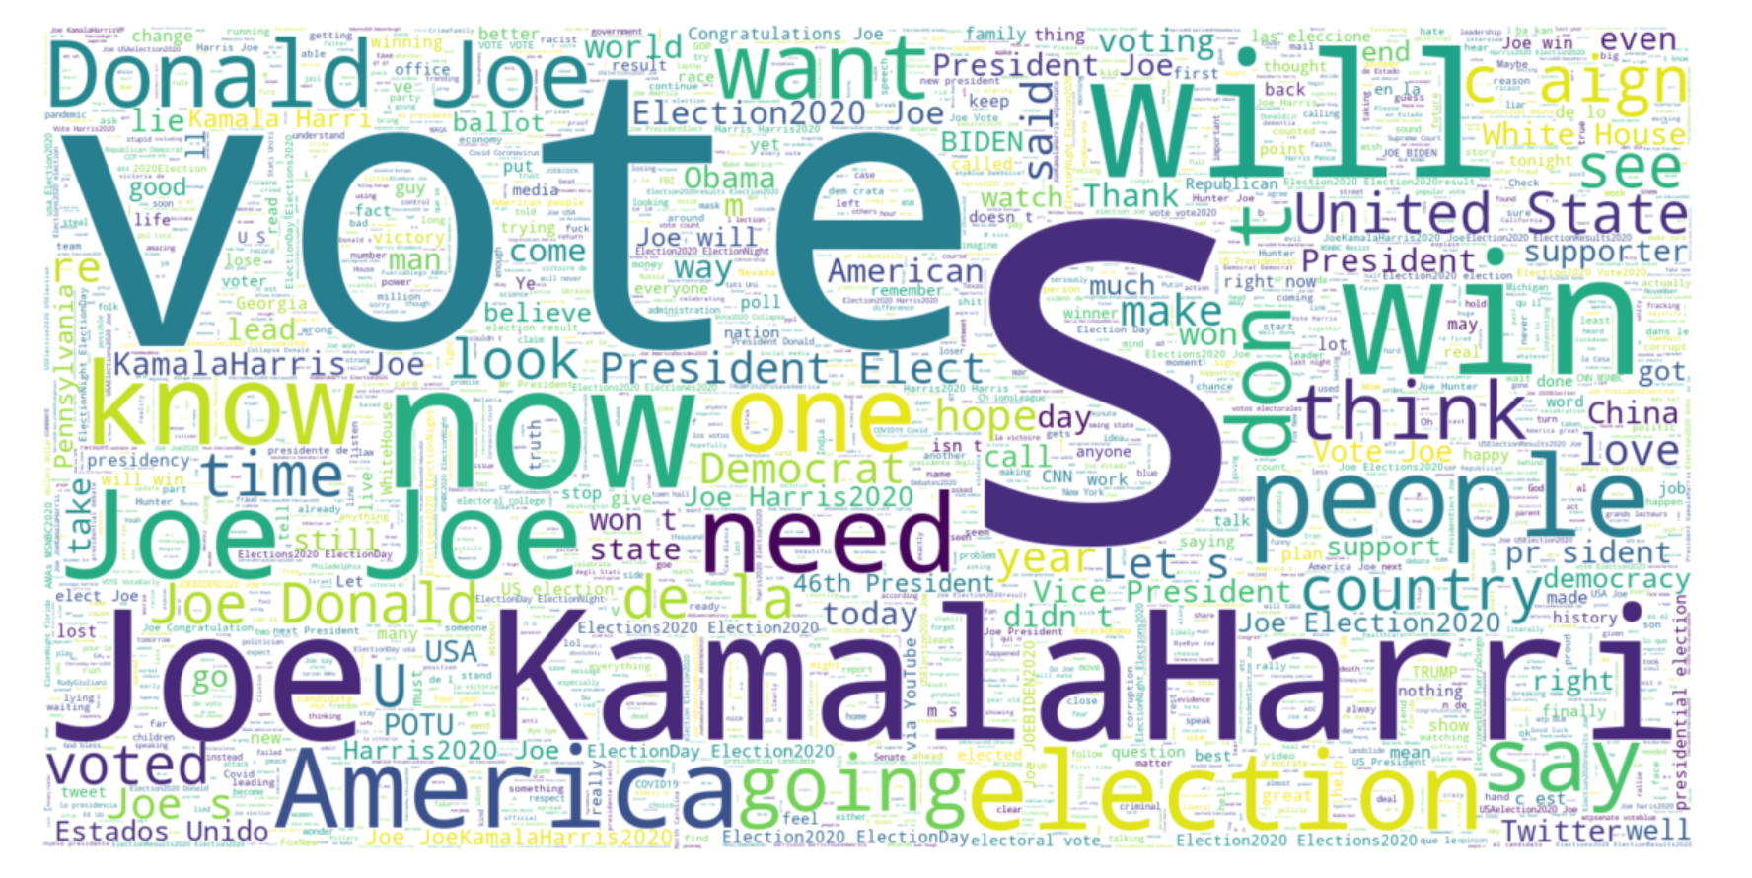
Mr. Joe Biden
Using Wordcloud library: visual representation of tweets about #biden

Slide 10
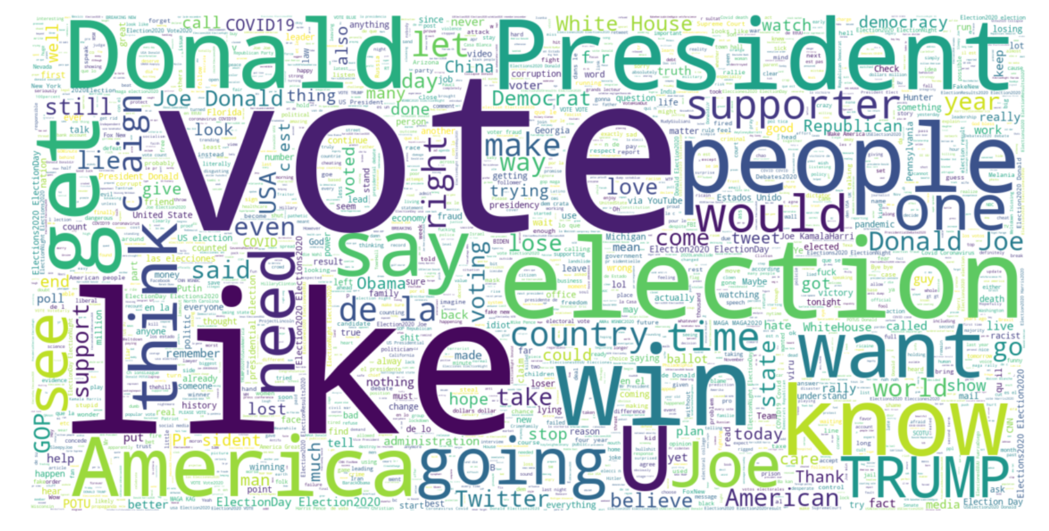
Mr. Donald Trump
Using Wordcloud library: visual representation of tweets about #trump

Slide 11
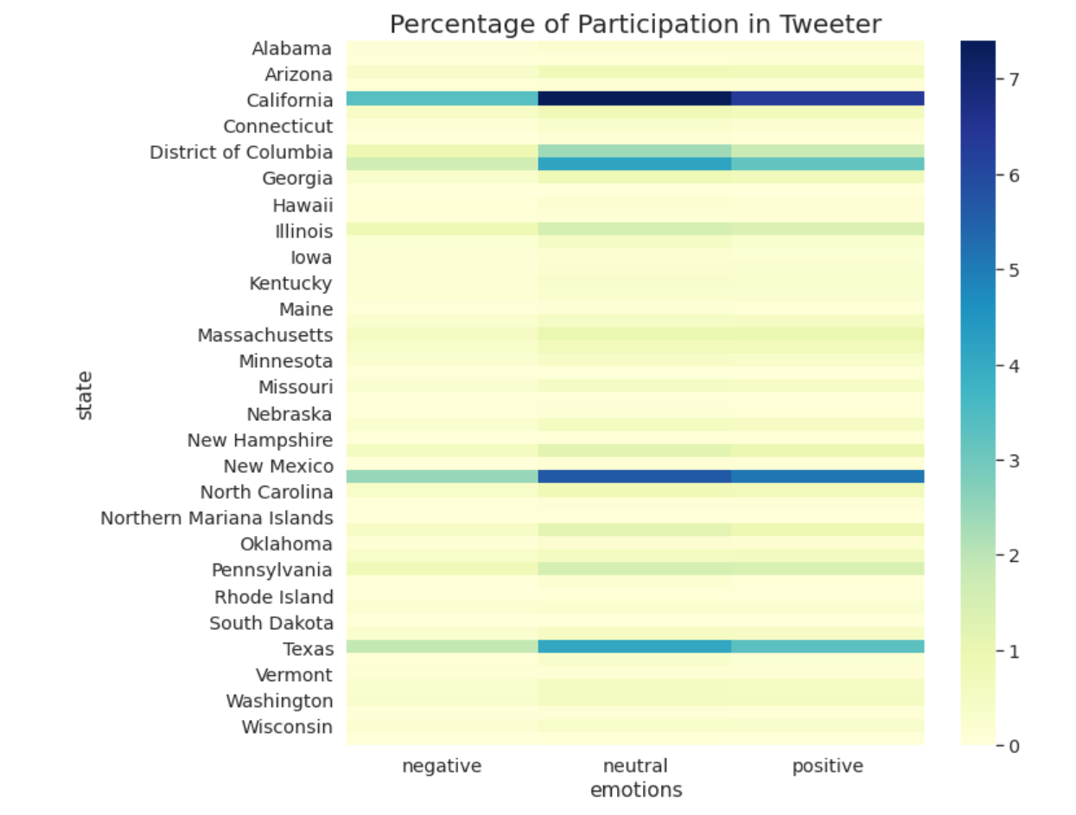
sentiment analysis of tweets
The Percentage of Tweets in every state
Using re library for cleaning tweets
Using textblob library for sentiment analysis
Using heatmap in seaborn library to show result

Slide 12
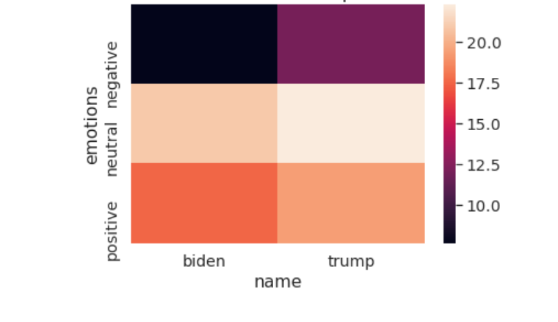
The Percentage of Positive & Negative Tweets in The USA
Notes:
Negative statements about Mr. Trump were much more than Mr. Biden

Slide 13
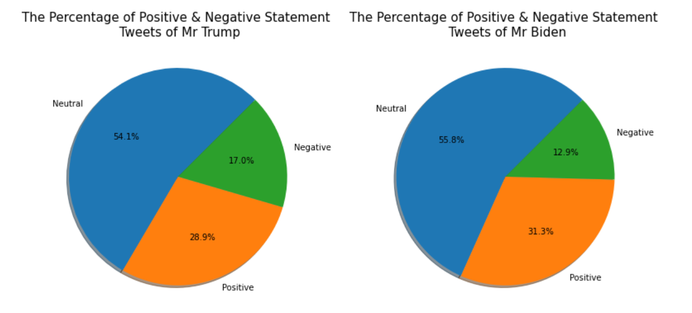
Prediction
Using textblob library to compute the percentage of positive and negative text at tweets
Notes:
People had a positive attitude in their tweets about Mr. Biden in comparison to Mr. Trump, and they wrote negative tweets about Mr. Trump rather than Mr. Biden.

Slide 14
